Slide 1
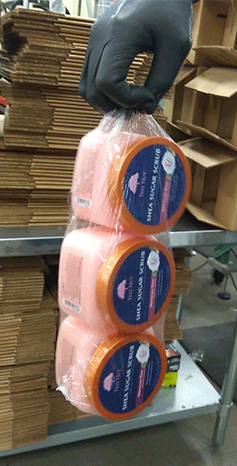
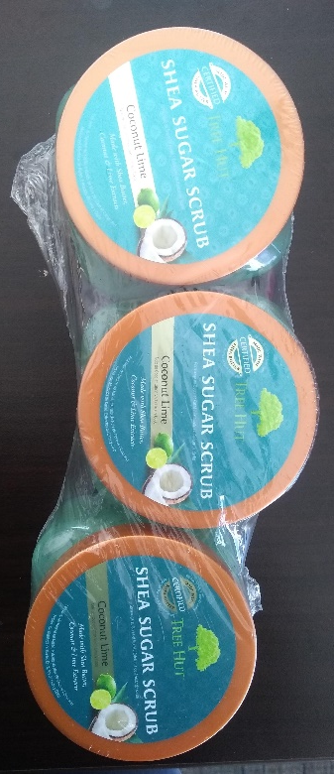
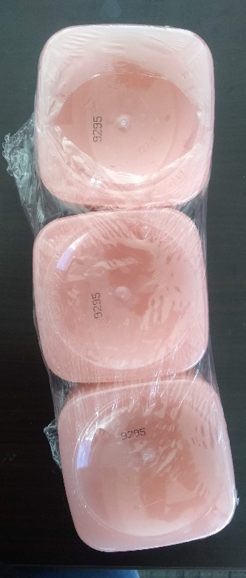
TREEHUT SUGAR SCRUB PANOPLY
Shrink Wrap - Ok
Rips of any size and quantity are ok. Loose shrink wrapping is ok . Only when it fails to contain all three when being picked up, then should it fail inspection.

